Slide 1

Milk POWDER Oscar Dowson odow003@aucklanduni.ac.nz Andy Philpott, Andrew Mason, Anthony Downward

Slide 2
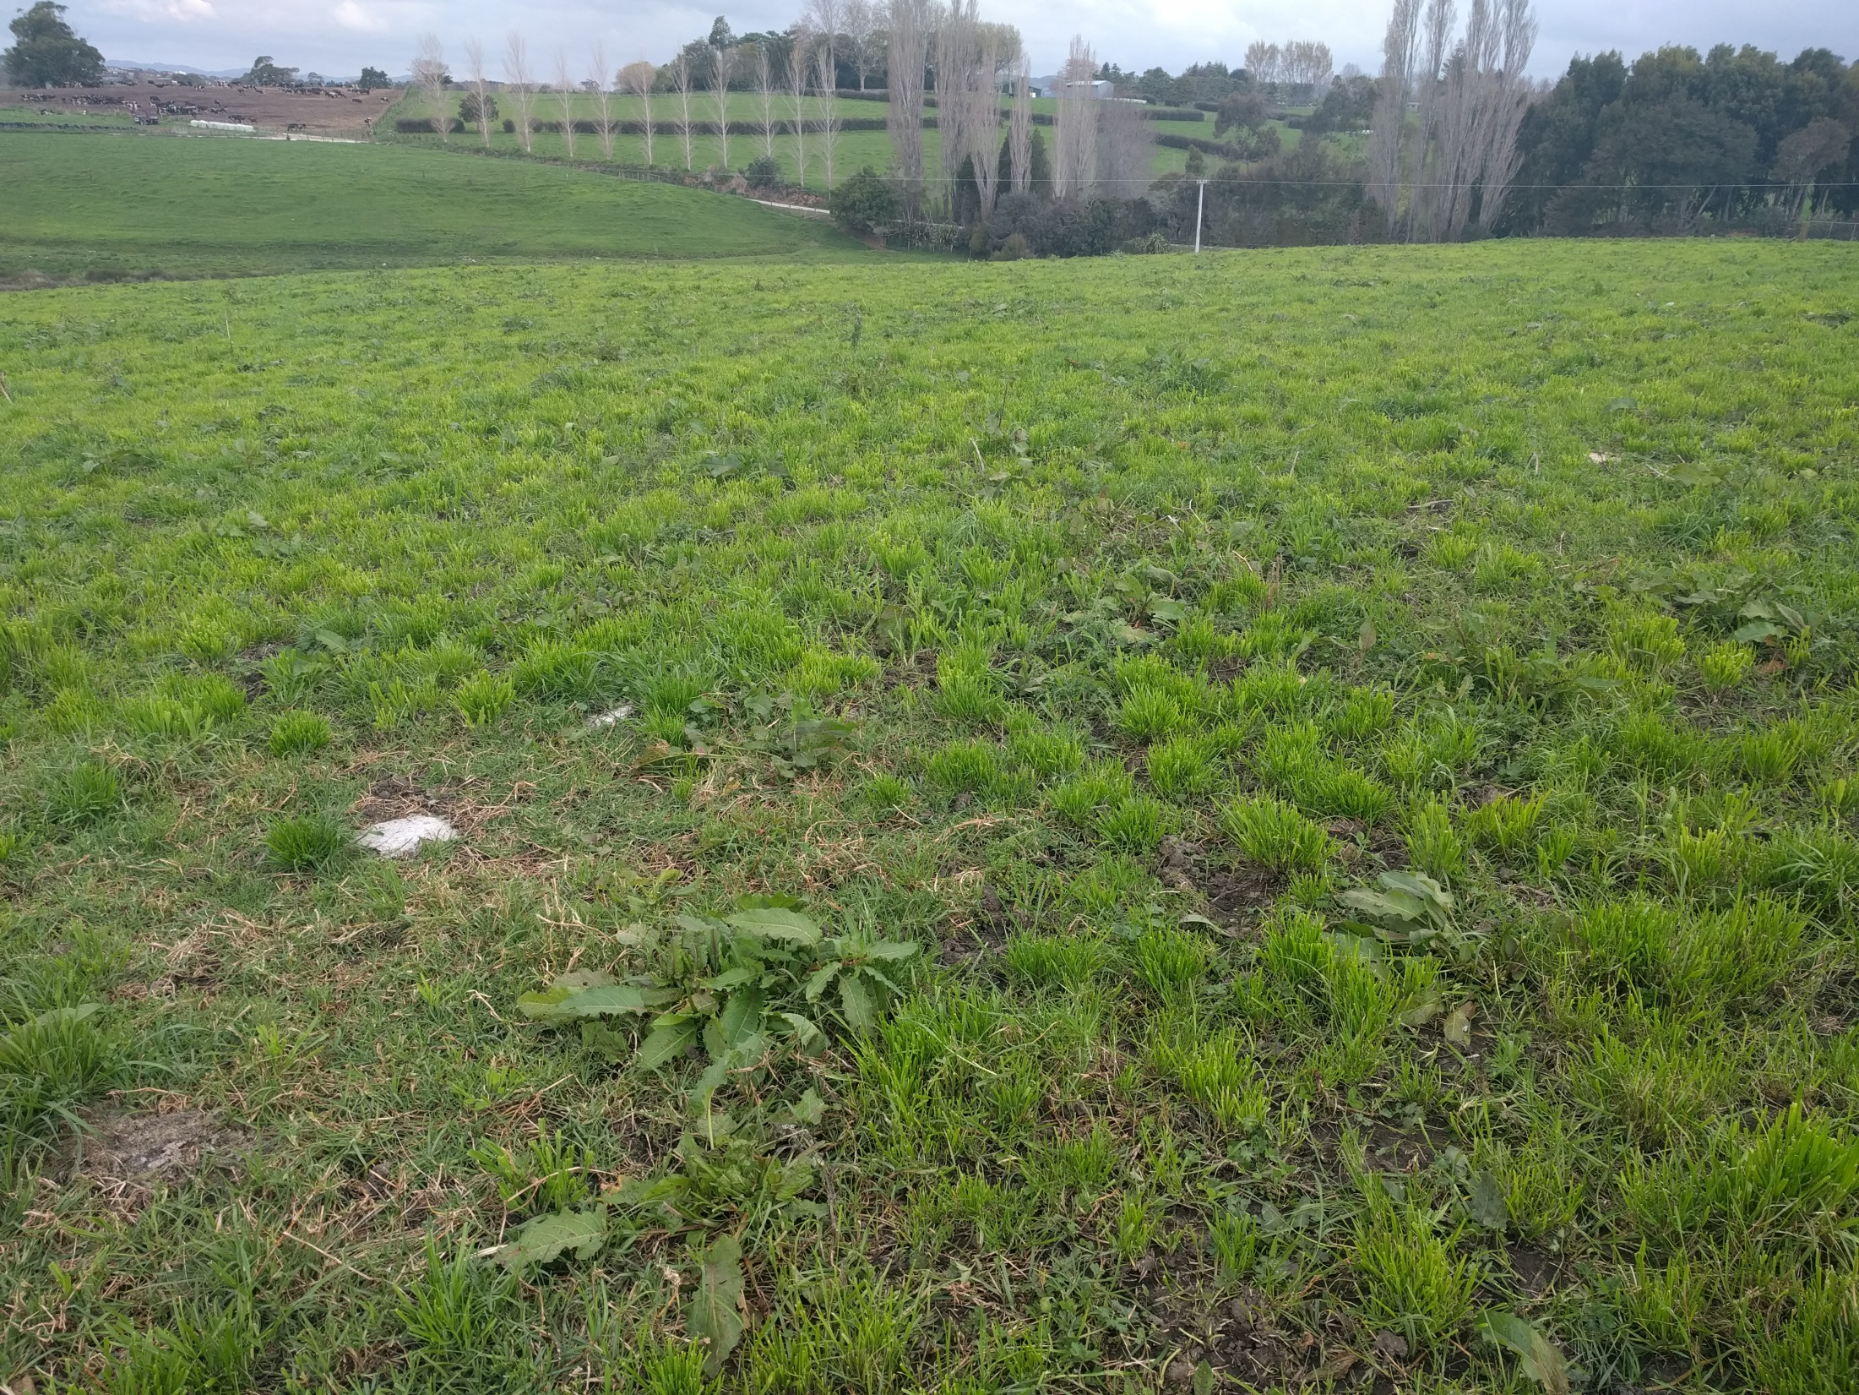

Slide 3
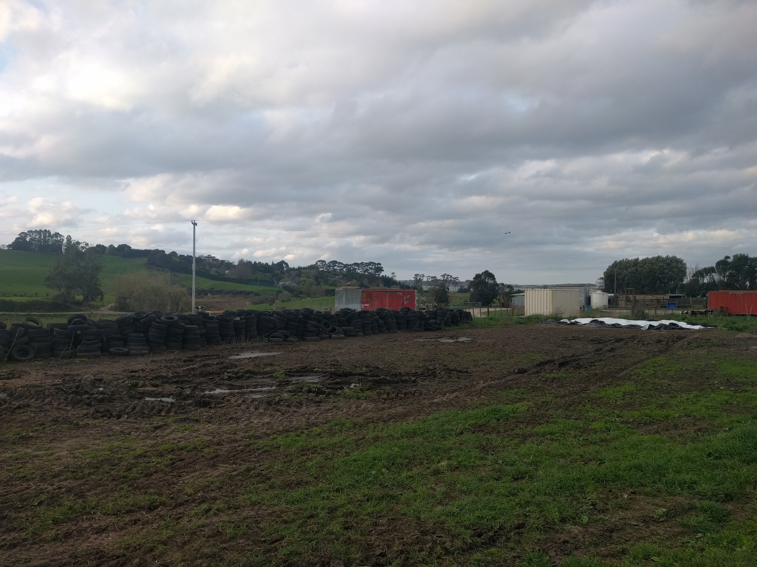

Slide 4
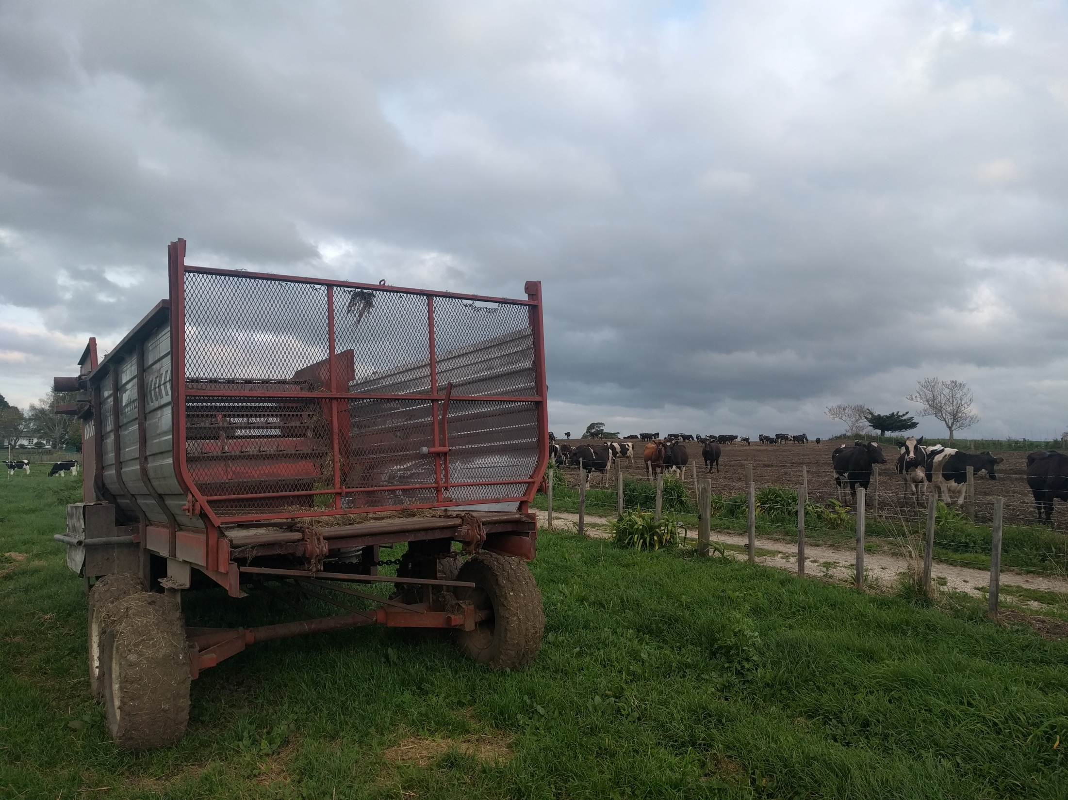
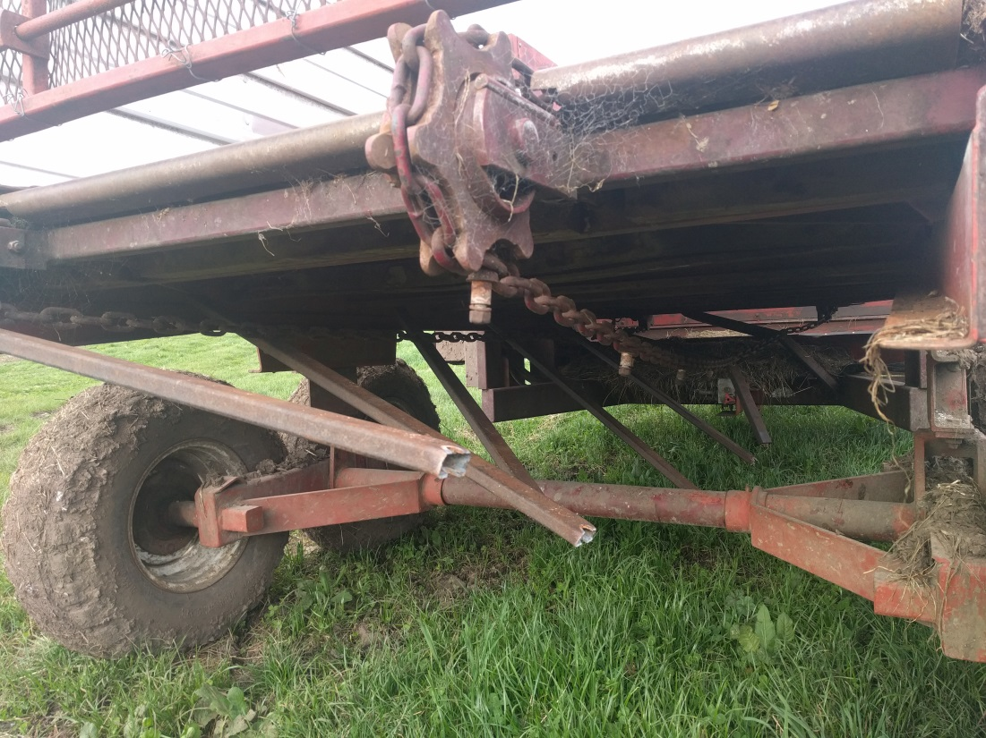

Slide 5
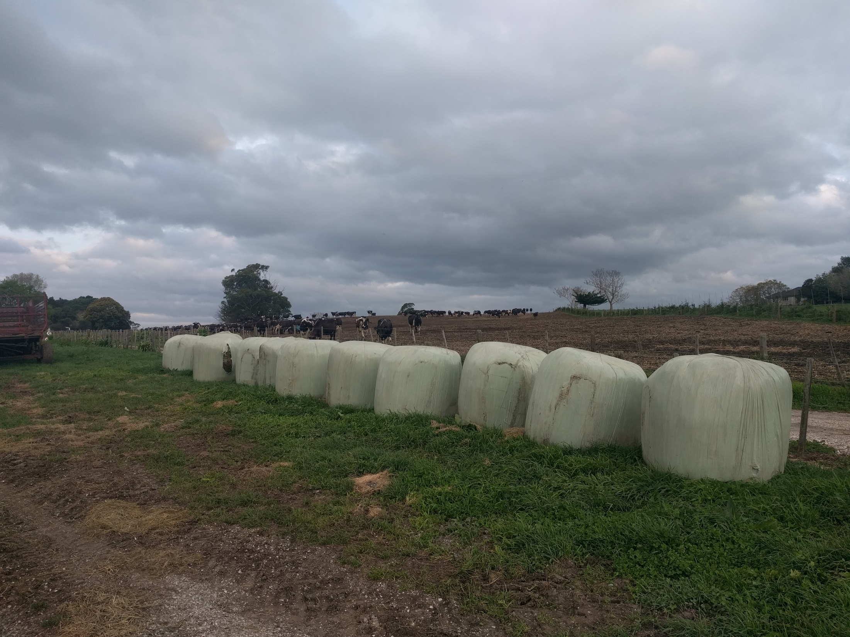

Slide 6
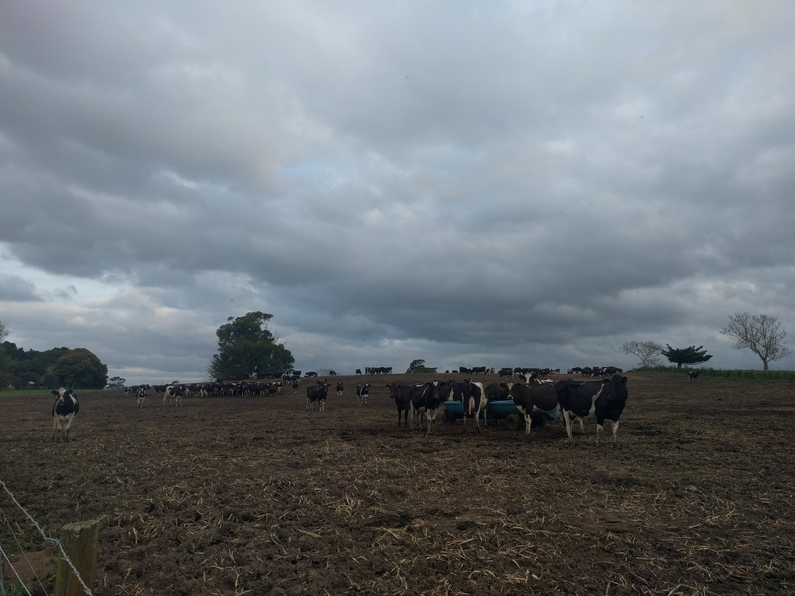

Slide 7
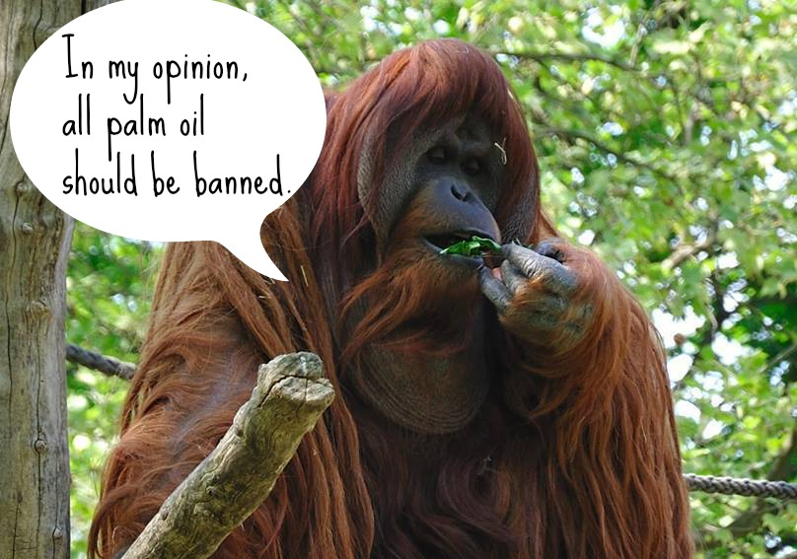

Slide 8
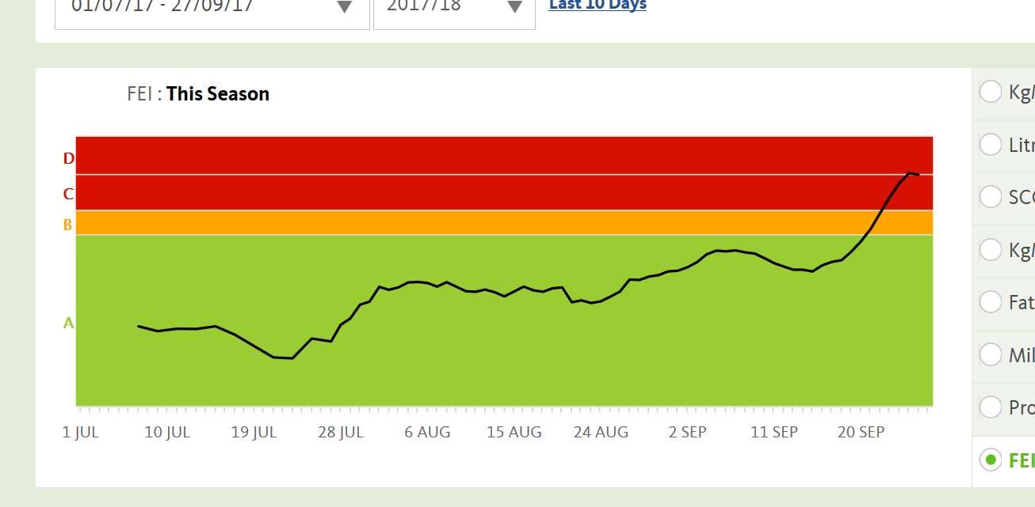

Slide 9
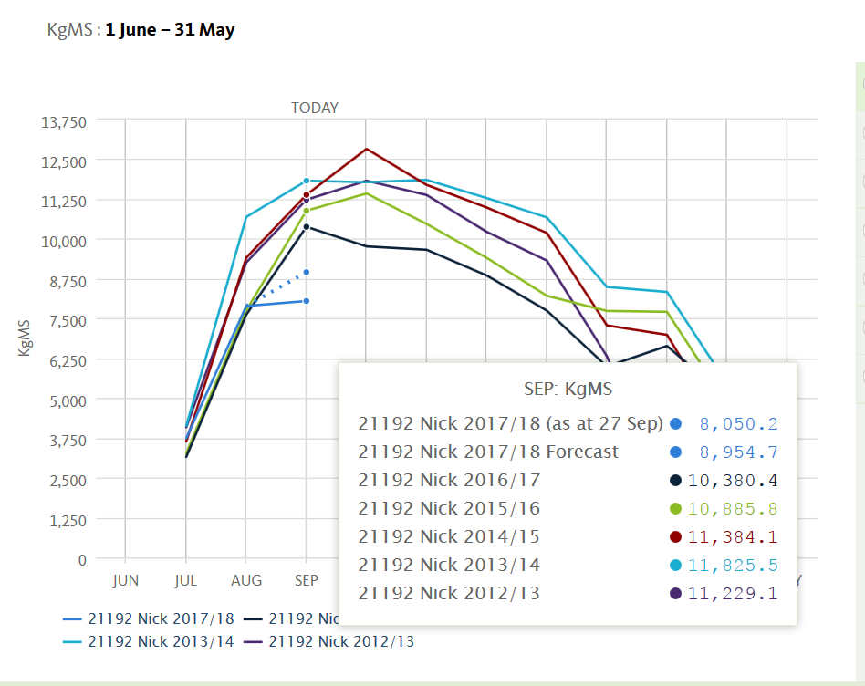

Slide 10
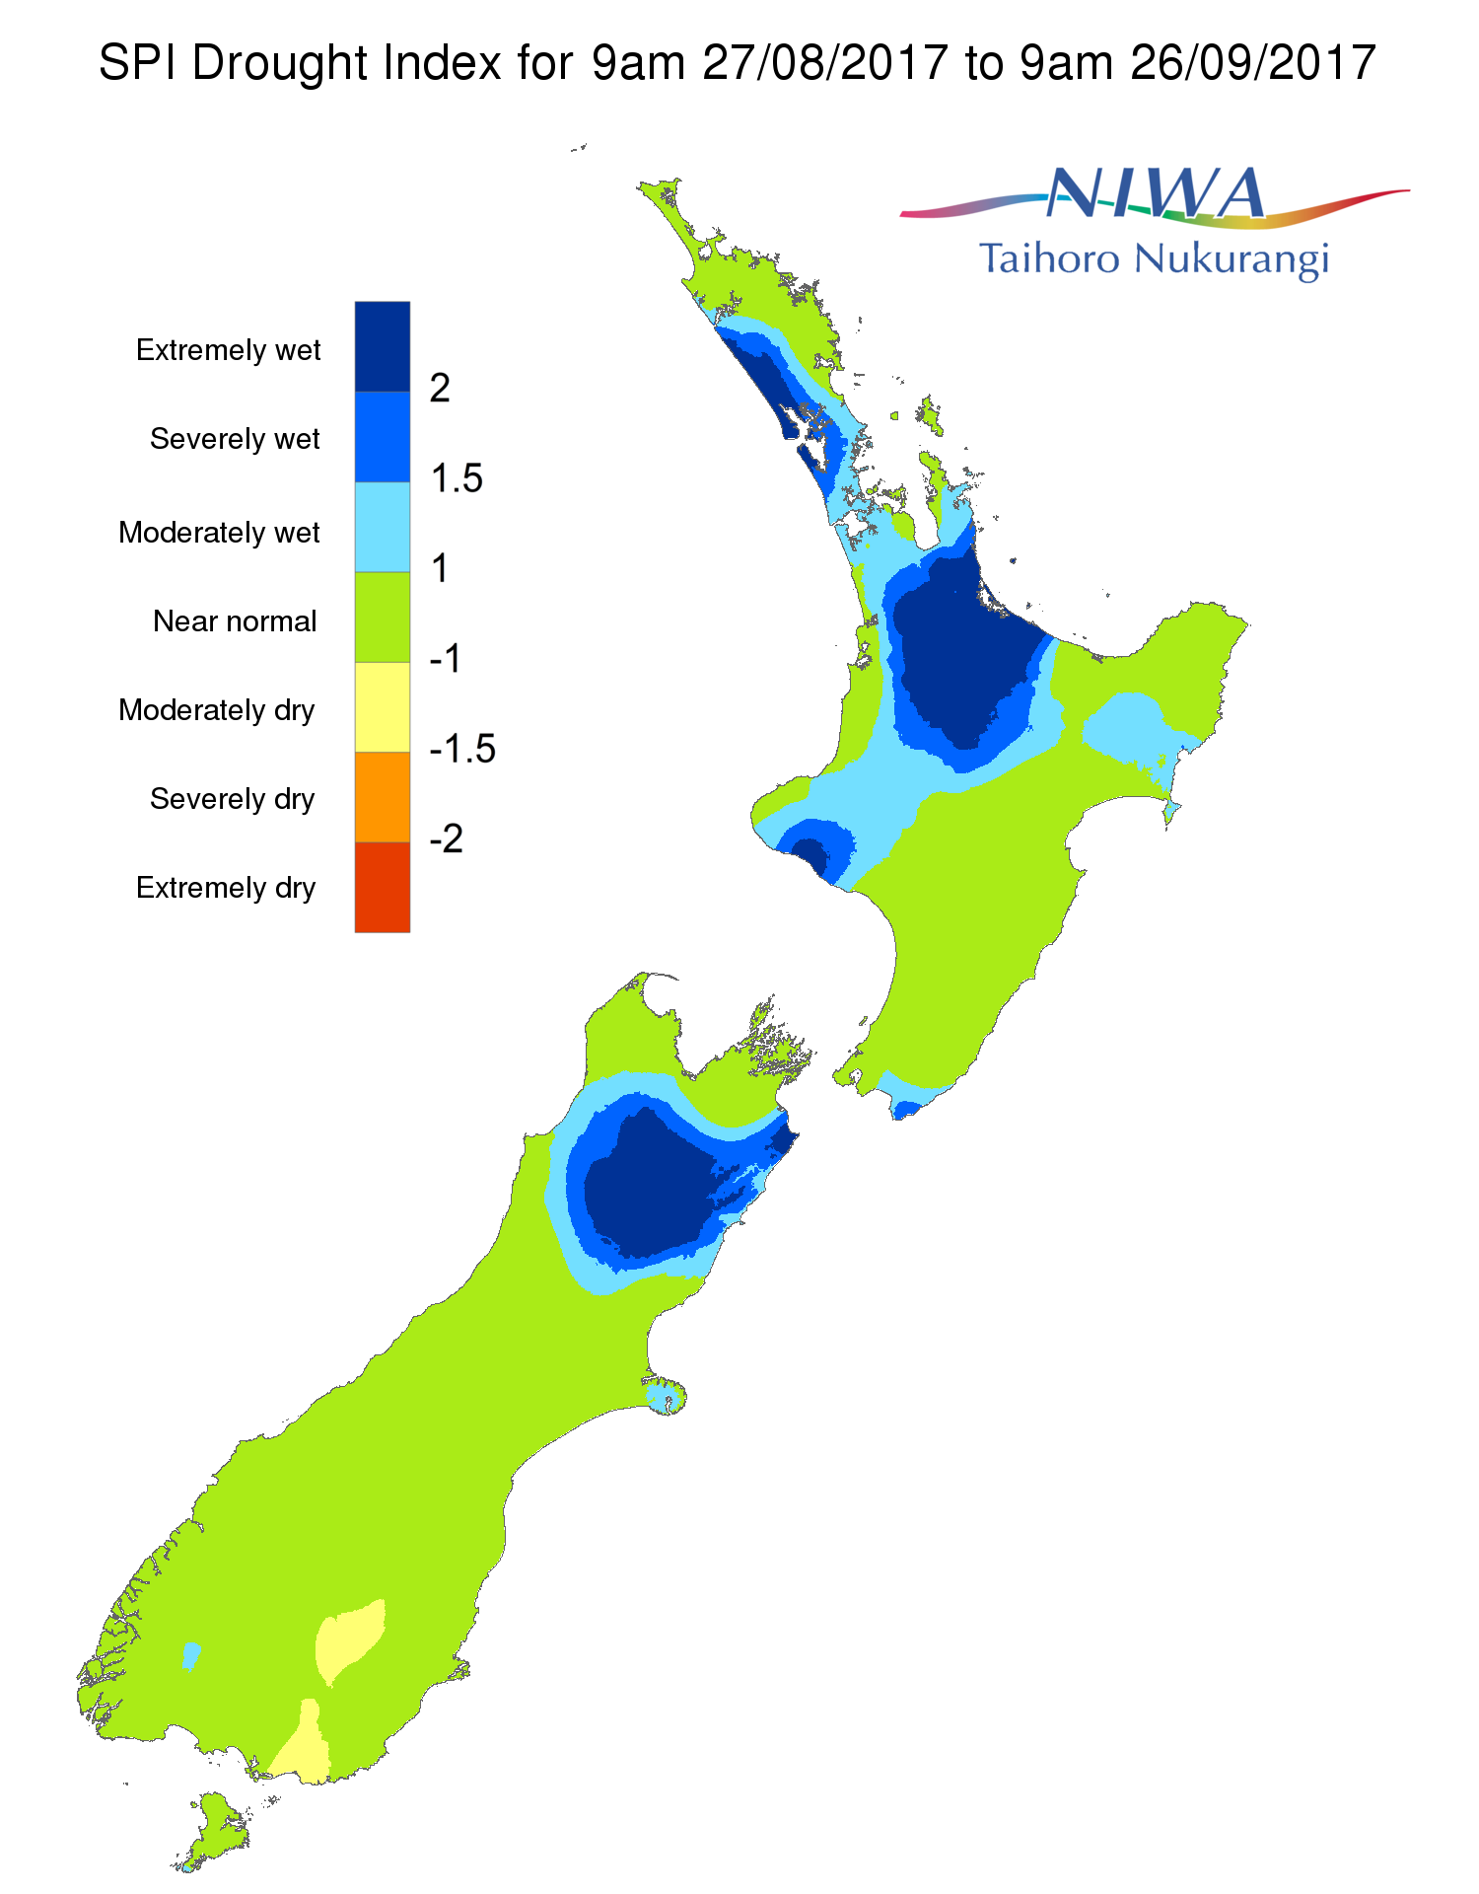
Our farm

Slide 11
What went wrong?
Good payout forecast
So maintained high stocking rate
Reasonable feed stocks on hand so didn’t buy more
Wet year (2x avg. rainfall) left paddocks damaged
Experience said: can’t have bad Summer, Autumn, Winter AND Spring right… the sun will come
Farm consultant’s advice: “don’t blink”

Slide 12
The Milk Production Optimiser incorporating Weather Dynamics and Economic Risk

Slide 13

Evaporation
Rainfall
Sunlight
Transpiration
Evaporation
potential
Temperature
Drainage

Slide 14
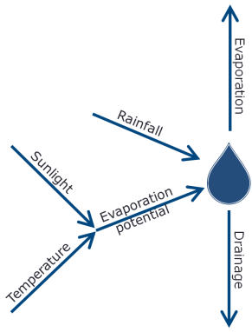

Growth
Fertiliser
Harvest
Transpiration
Feed
Nitrogen

Slide 15

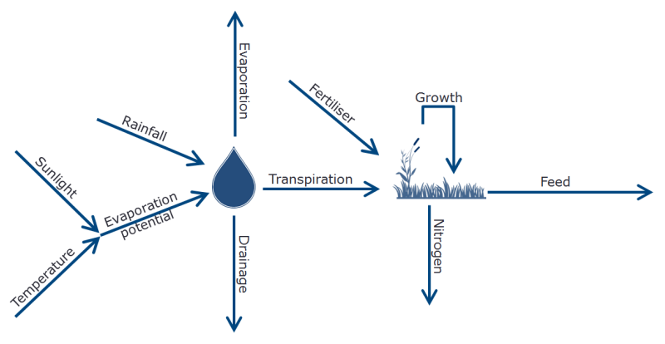
Buy
Harvest
Feed

Slide 16
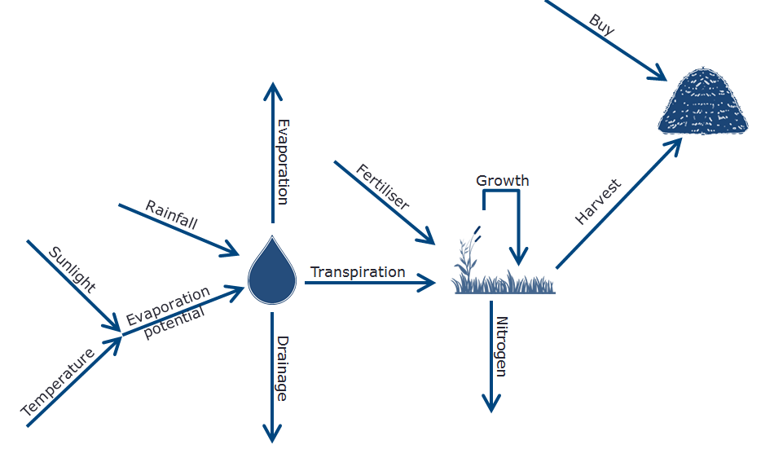

Feed
Feed
Feed
Feed
Dry
Milk
$
FGMP

Slide 17
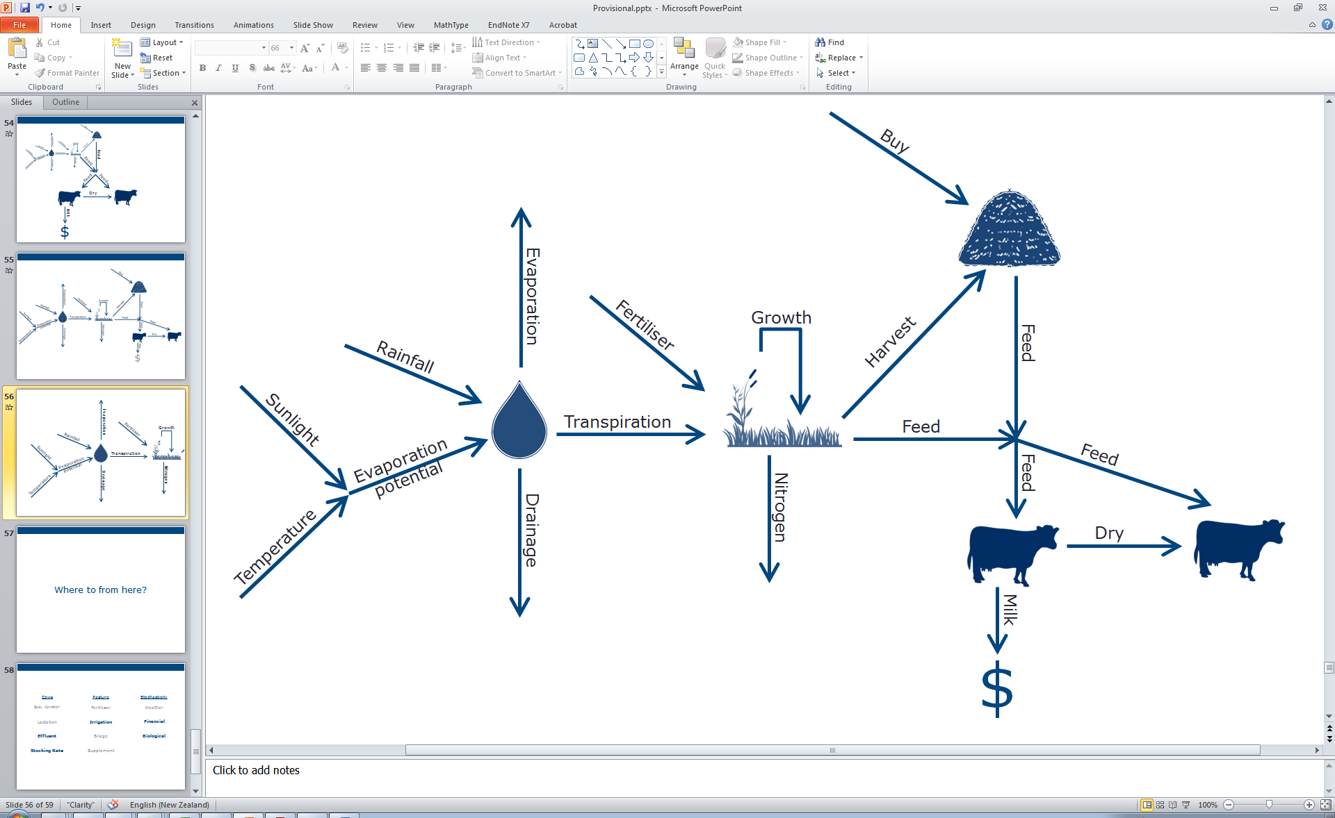
FGMP

Slide 18
Weather
Model
FGMP

Slide 19
Weather
Model
Plant
Model
FGMP

Slide 20
Weather
Model
Plant
Model
Production
Model
FGMP

Slide 21
Storage
Model
(Optional)
Weather
Model
Plant
Model
Production
Model
FGMP

Slide 22
Storage
Model
(Optional)
Weather
Model
Plant
Model
Production
Model
Price
Model
FGMP

Slide 23
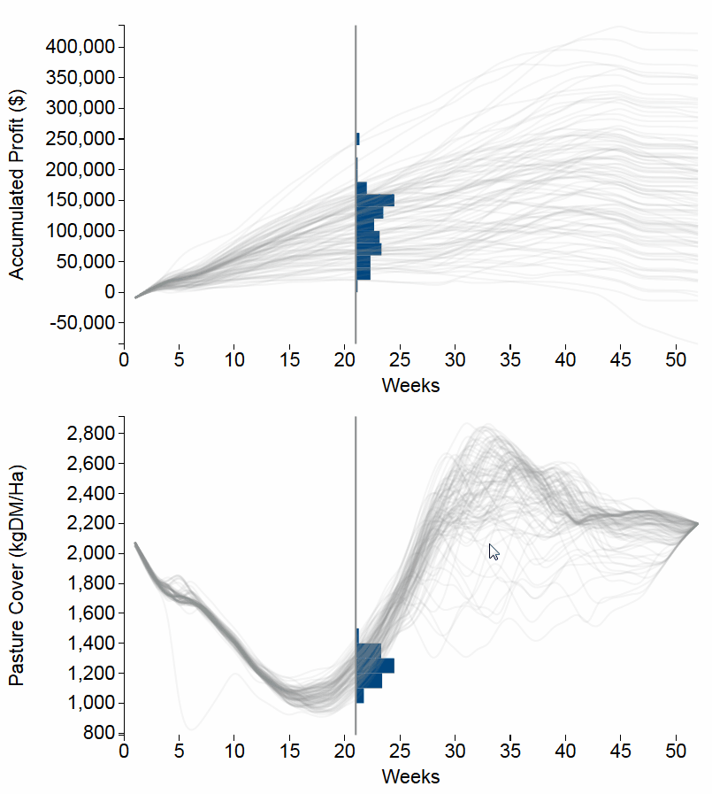
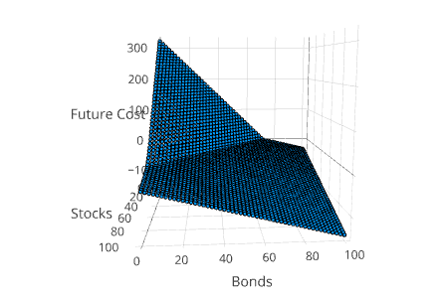
SDDP.jl
An open-source Julia library for solving multi-stage stochastic programs using SDDP:
- simple
- easy to use
- fast
- lots of examples
- pretty pictures
github.com/odow/SDDP.jl

Slide 24
Dowson-Farms A Case Study

Slide 25
Historical Weather Data

Slide 26
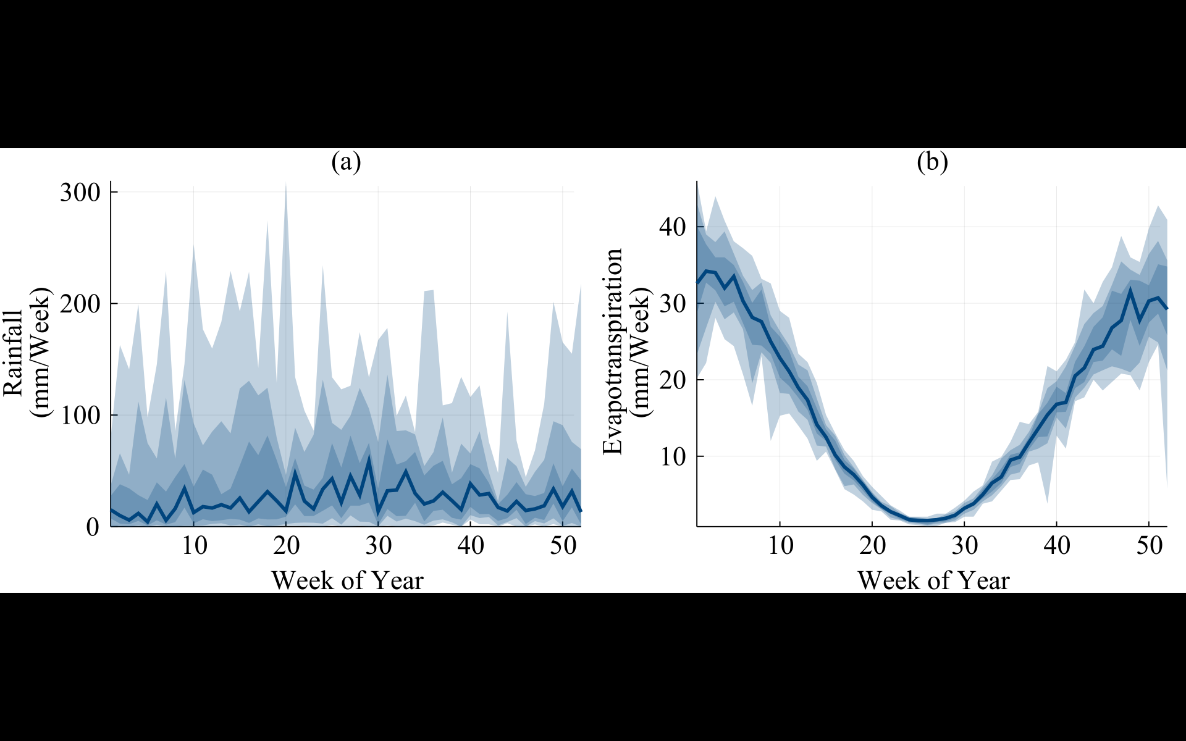

Slide 28
Historical Farm Data

Slide 29
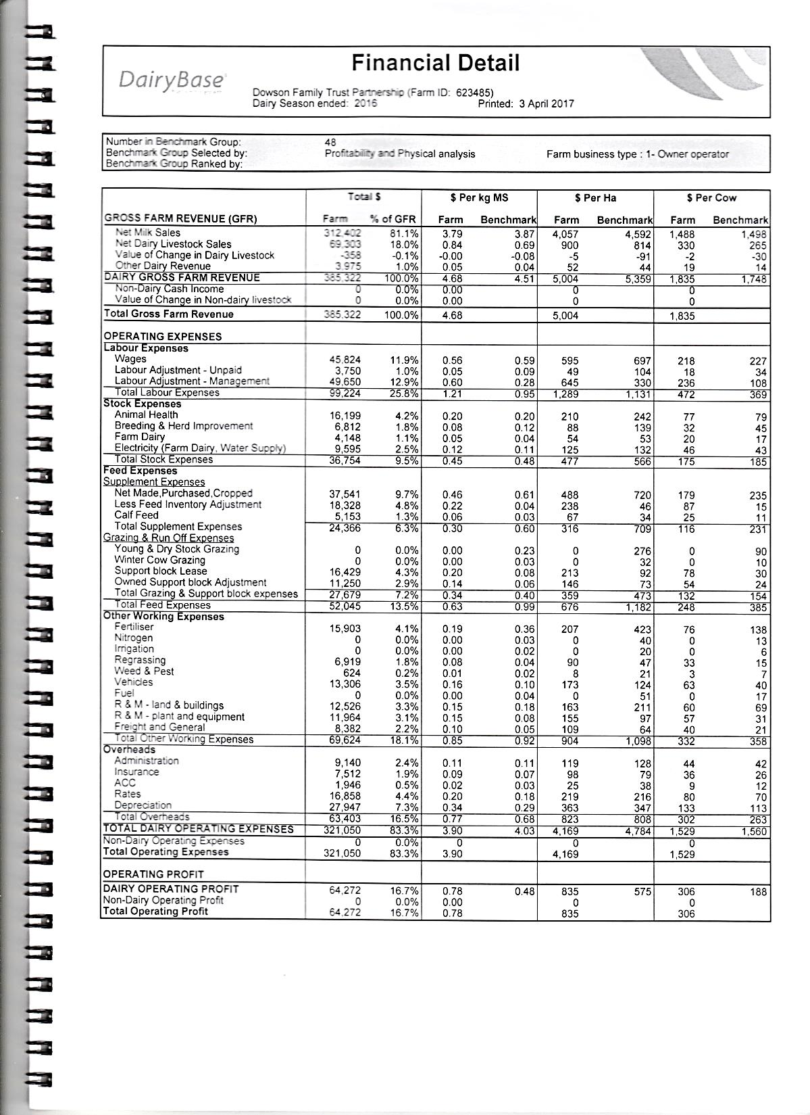
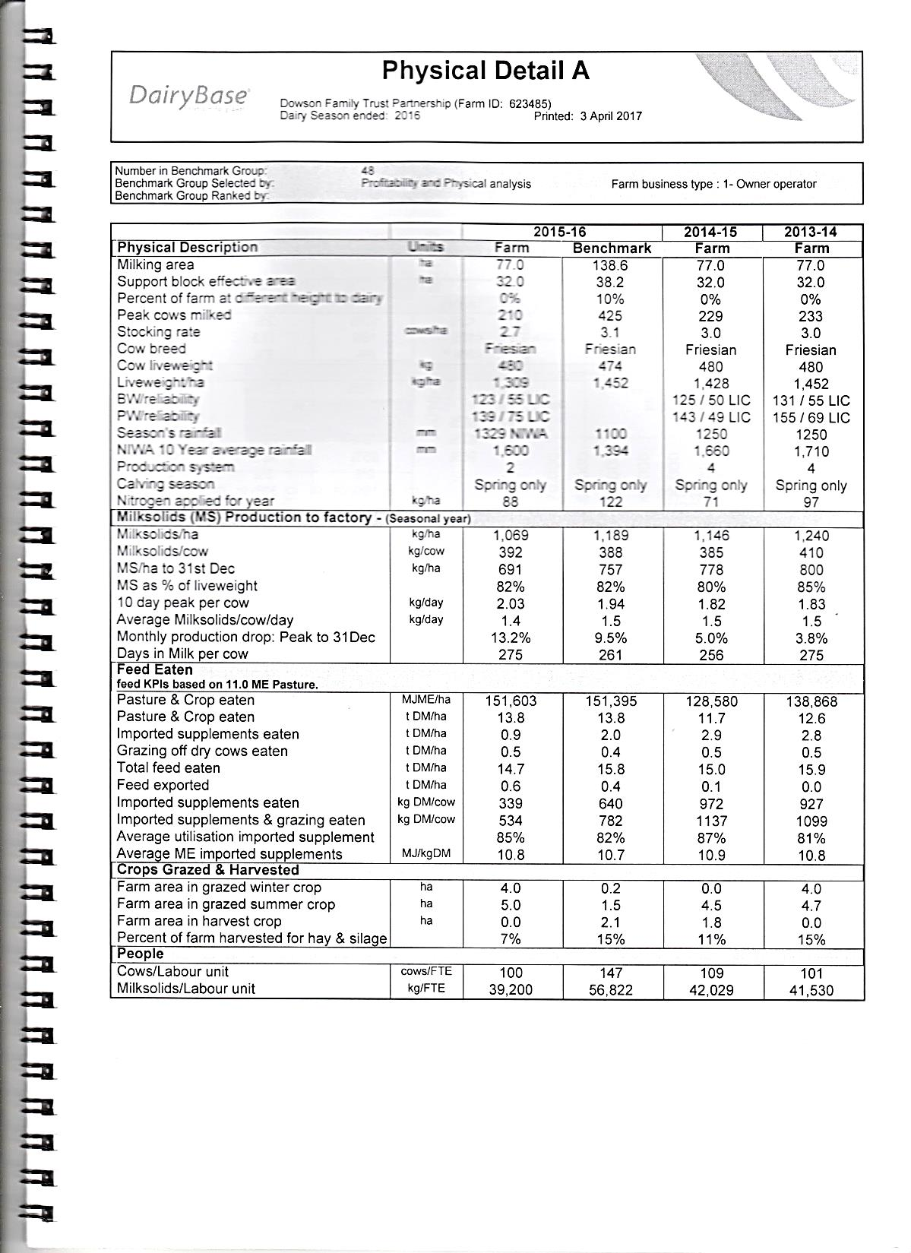
How much milk was produced

Slide 30
How much milk was produced
How long the cows were milked for

Slide 31
How much milk was produced
How long the cows were milked for
How much food they ate

Slide 32
How much palm kernel cost
How much milk was produced
How long the cows were milked for
How much food they ate

Slide 33
How much palm kernel cost
How much milk was produced
How long the cows were milked for
How much food they ate
Operating profit

Slide 34
Saving the Orangutans
Orang-utan: “person of the forest”

Slide 36
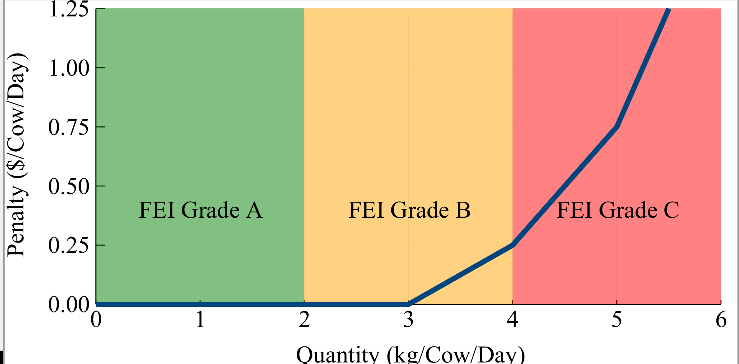

Slide 37
Forecasting The Milk Price

Slide 38
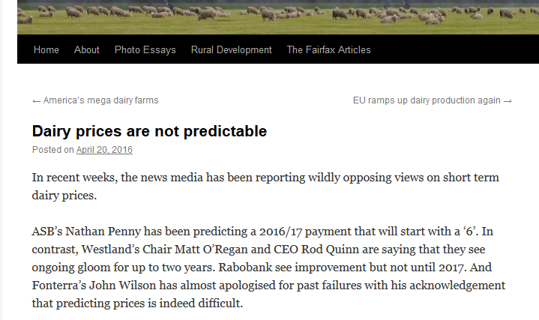
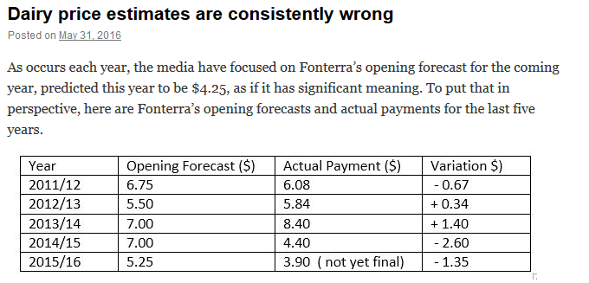

Slide 40
2
0
4
0
2

Slide 41
$8
1/9
$7
2/9
$6
3/9
$5
2/9
$4
1/9
T=1
…
T=24
T=25
…
T=51
T=52

Slide 42
Results

Slide 43
$8
1/9
$7
2/9
$6
3/9
$6
$5
2/9
$4
1/9
T=1
…
T=24
T=25
…
T=51
T=52

Slide 44
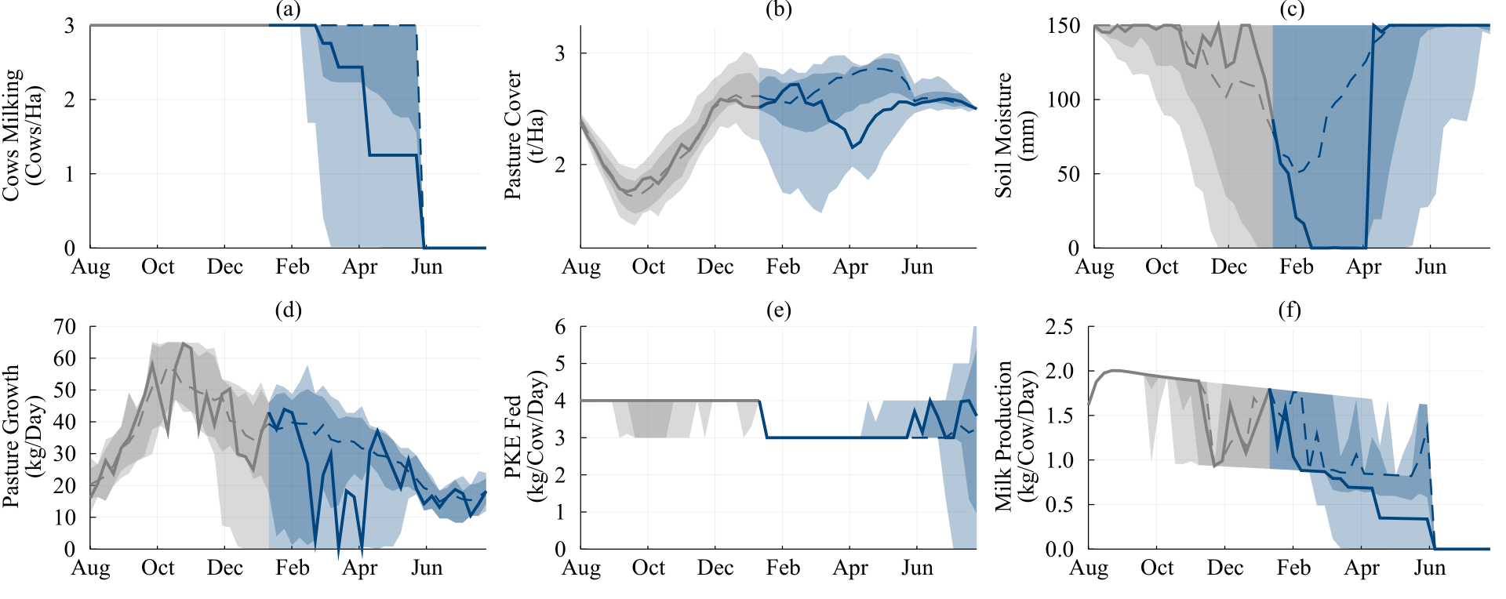
Low Price Scenarios

Slide 45
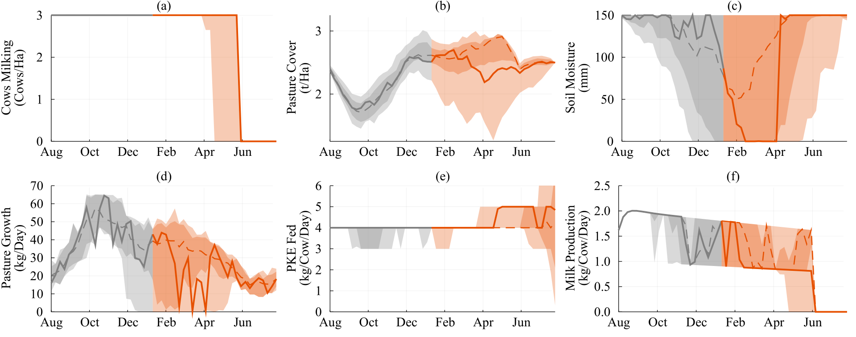
High Price Scenarios

Slide 46
Can we do better?

Slide 47
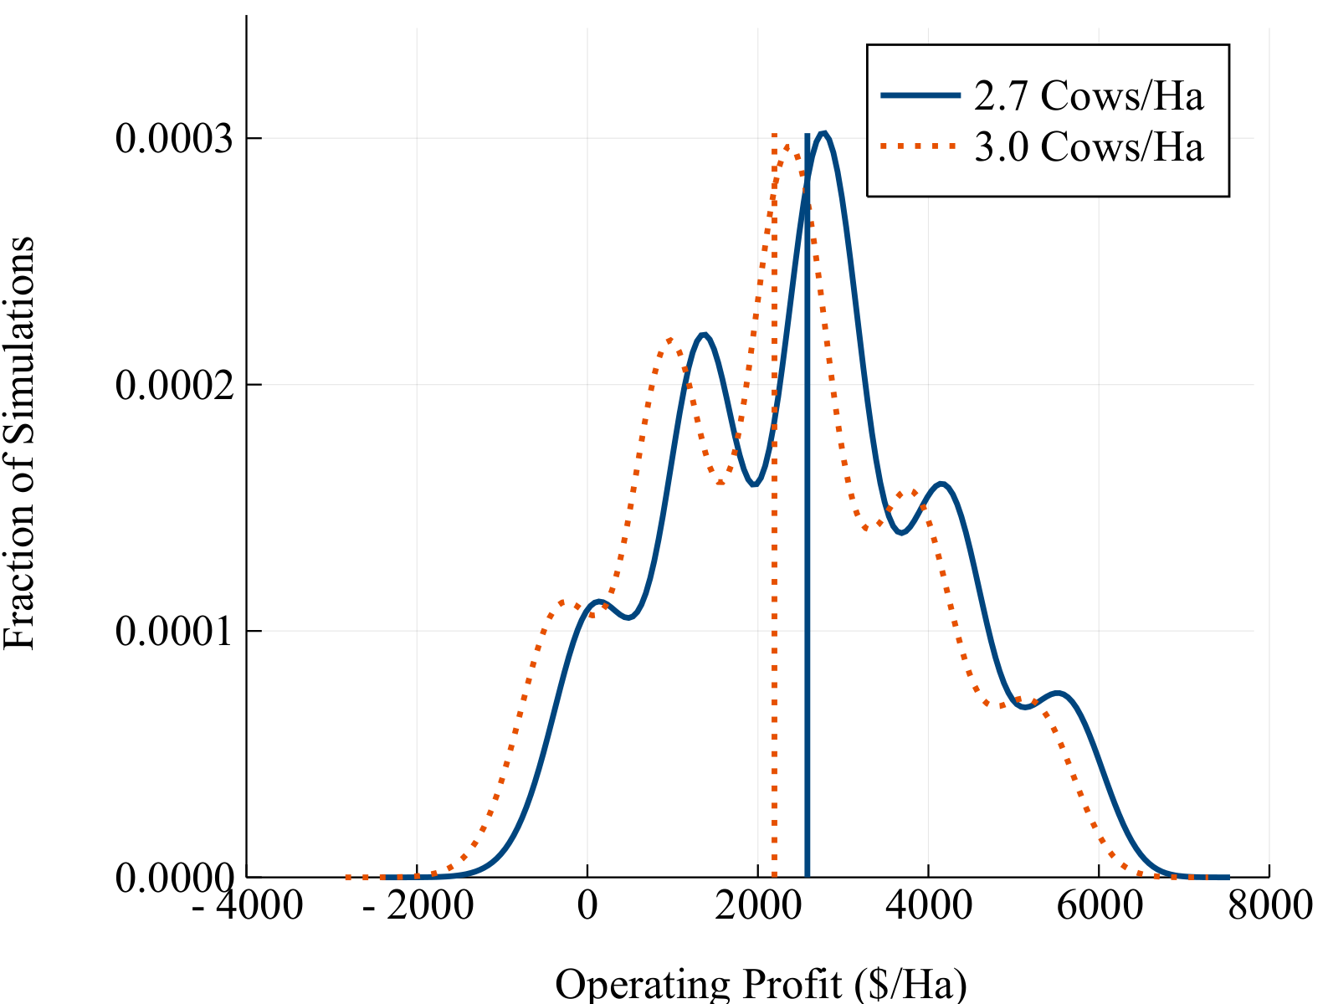
Lowering the Stocking Rate
+$386/Ha

Slide 48
What next?
A better price model
A better weather model
A better animal model
Milk Price Futures
Nitrogen
Ability to sell/buy stock
Sheep and Beef?
Cropping?

Slide 49
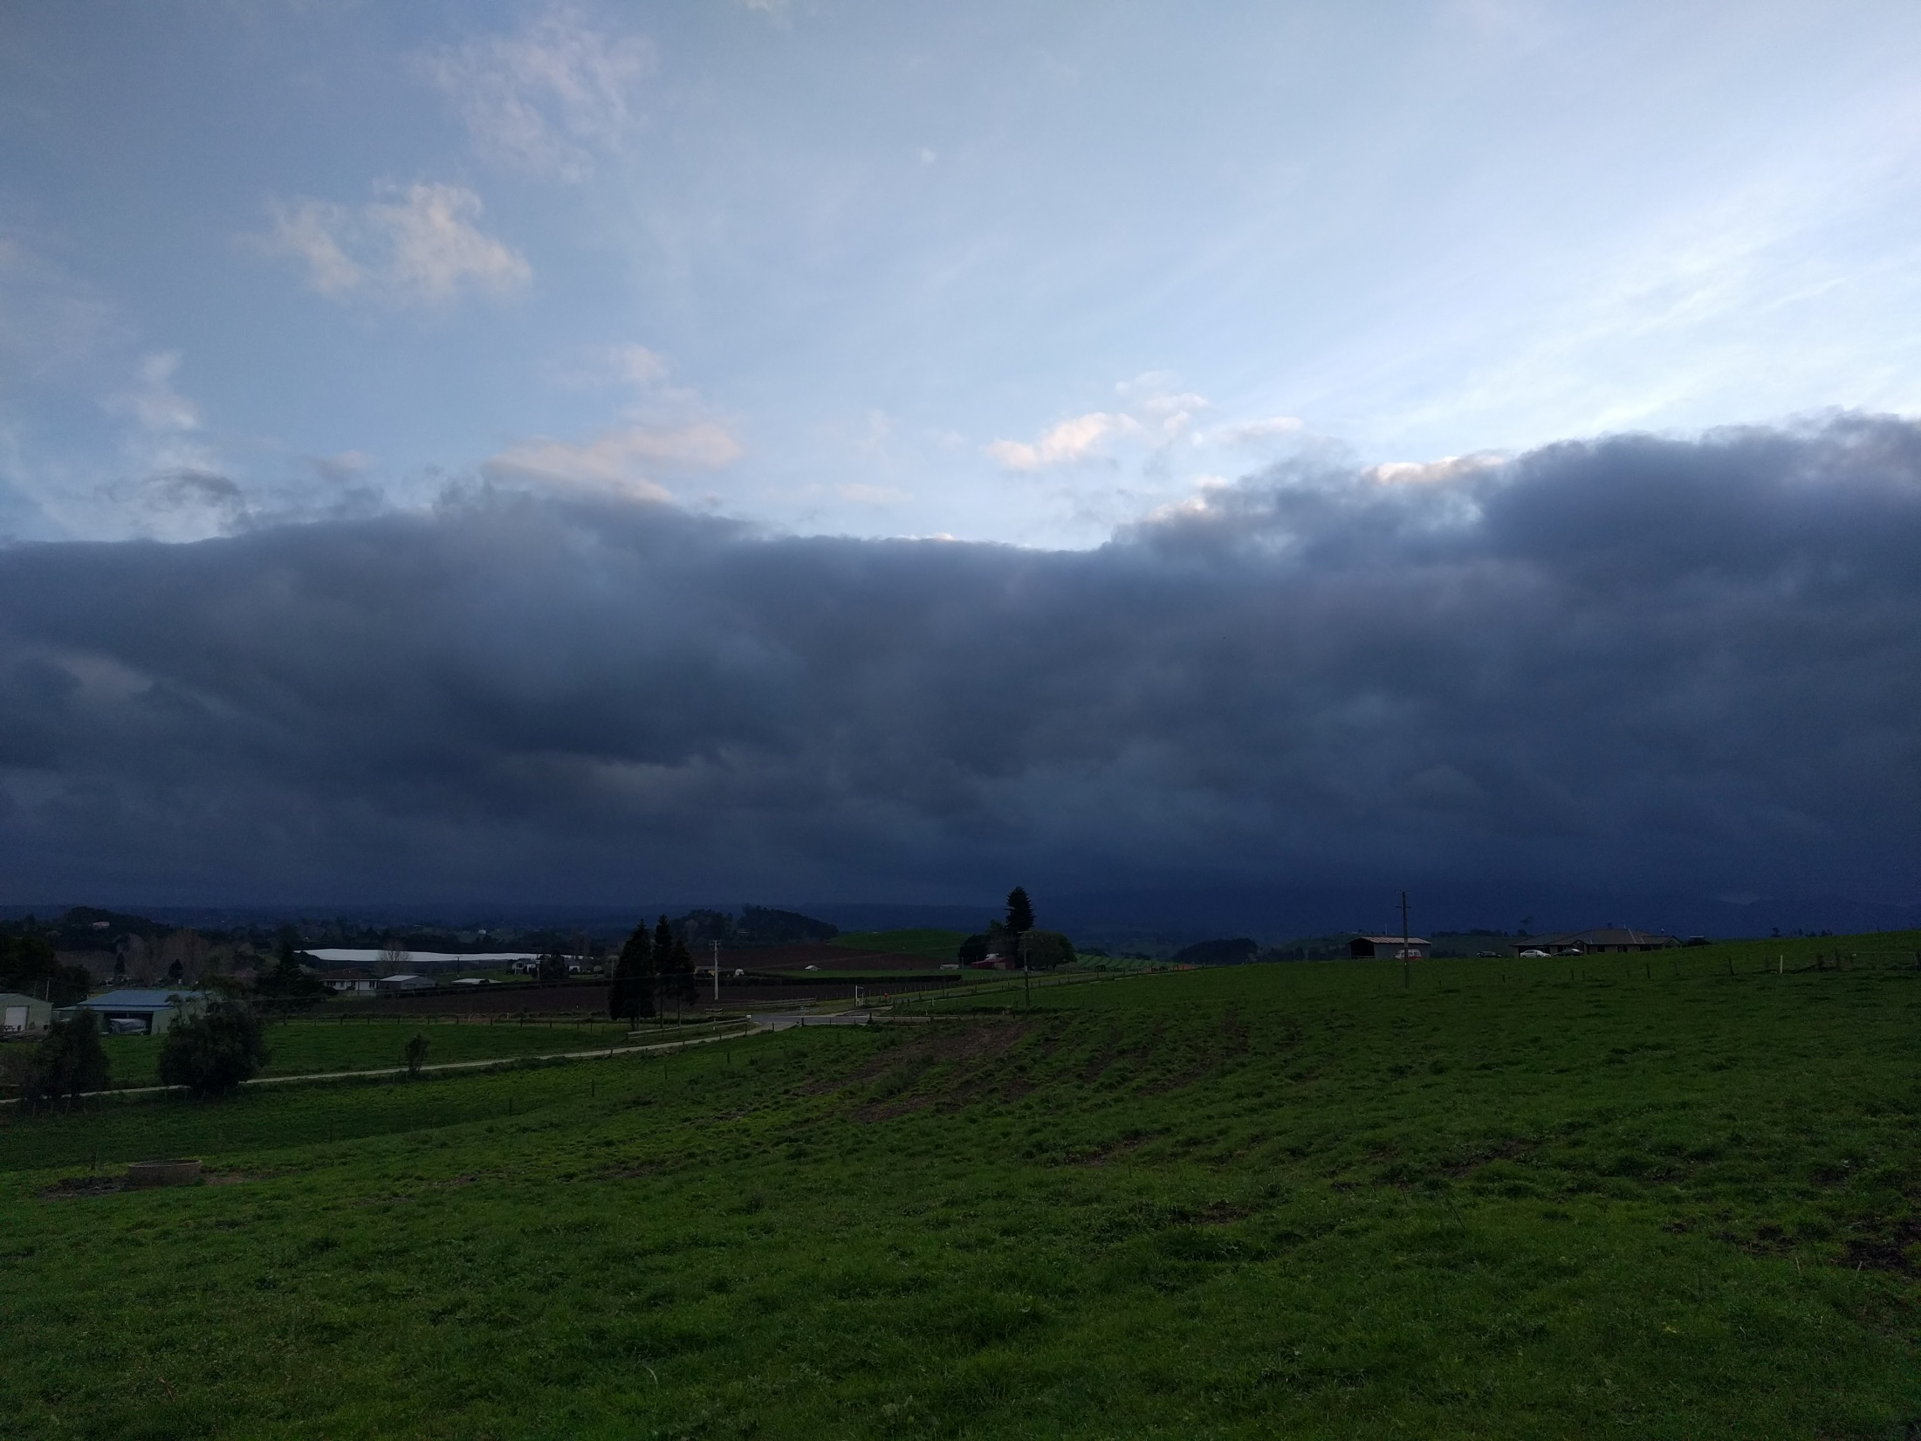

Slide 50
SDDP.jl A Julia library for Stochastic Dual Dynamic Programming Oscar Dowson odow003@aucklanduni.ac.nz

Slide 51
The Air-Conditioning Example

Slide 52
The air-conditioning problem
Consider the problem of producing air-conditioners over a period of three months.
During standard working hours, the factory can produce 200 units per month at a cost of $100/unit.
Unlimited overtime can be scheduled, however it costs $300 to produce a unit.
In the first month, there is a known demand of 100 units.
In months two and three, there is an equally likely demand of 100 or 300 units.
Air-conditioners can be stored between months at a cost of $50/unit
All demand must be met.

Slide 53
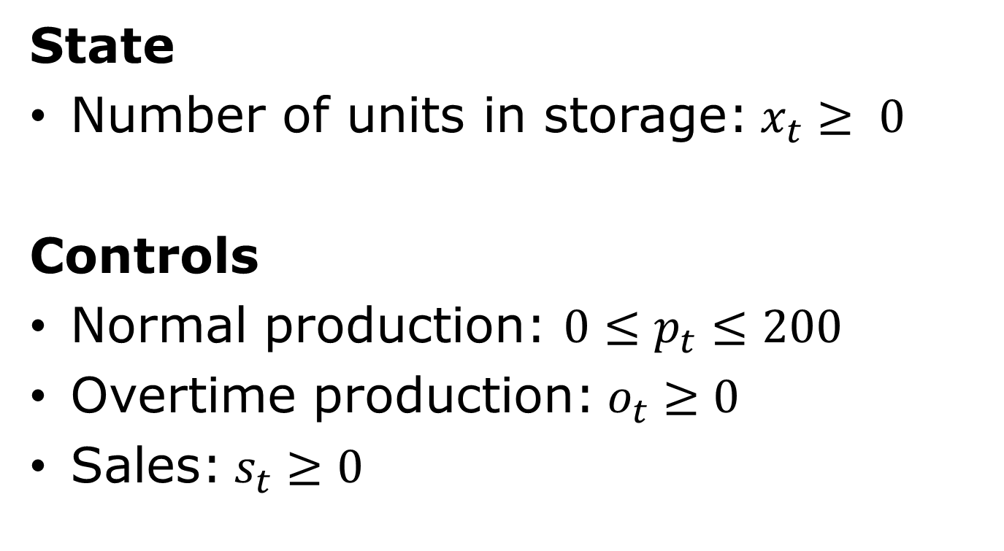
The air-conditioning problem
State
Number of units in storage:$x_{t}≥ 0$
Controls
Normal production: $0≤p_{t}≤200$
Overtime production:$o_{t}≥0$
Sales:$s_{t}≥0$

Slide 54
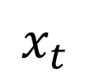
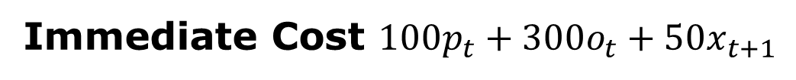
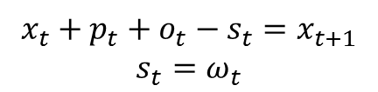
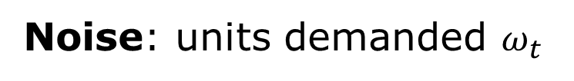

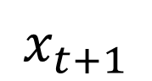
The air-conditioning problem
Noise: units demanded $ω_{t}$
Month $t$
$$x_{t}$$
Dynamics
$$x_{t+1}$$
$$x_{t}+p_{t}+o_{t}−s_{t}=x_{t+1}$$
$$s_{t}=ω_{t}$$
Immediate Cost $100p_{t}+300o_{t}+50x_{t+1}$

Slide 55
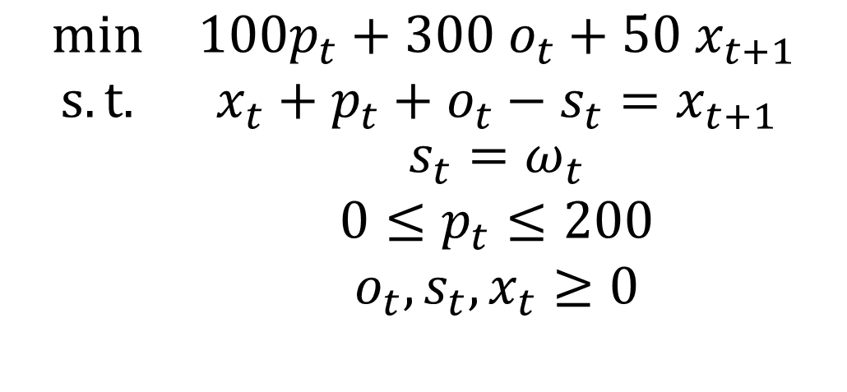
The air-conditioning problem
$$\begin{matrix}min & 100p_{t}+300 o_{t}+50 x_{t+1} \\ s.t. & x_{t}+p_{t}+o_{t}−s_{t}=x_{t+1} \\ & \begin{aligned}s_{t}=ω_{t} \\ 0≤p_{t}≤200 \\ o_{t}, s_{t}, x_{t}≥0\end{aligned}\end{matrix}$$

Slide 56
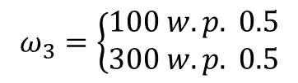
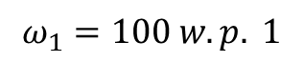
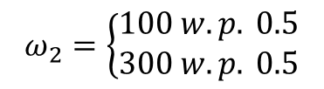
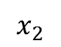
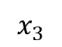
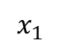
The air-conditioning problem
$$ω_{1}=100 w.p. 1$$
$$ω_{2}=\left\{\begin{aligned}100 w.p. 0.5 \\ 300 w.p. 0.5\end{aligned}\right.$$
$$ω_{3}=\left\{\begin{aligned}100 w.p. 0.5 \\ 300 w.p. 0.5\end{aligned}\right.$$
$$x_{1}$$
Month 1
$$x_{2}$$
Month 2
$$x_{3}$$
Month 3

Slide 57
The air-conditioning problem
using JuMP, SDDP, Clp
m = SDDPModel(
stages = 3,
objective_bound = 0.0,
sense = :Min,
solver = ClpSolver()
) do sp, t
@state(sp, xt_1 >= 0, xt == 0)
@variables(sp, begin
0 <= pt <= 200
ot >= 0
st >= 0
end)
@constraint(sp, xt + pt + ot – st == xt_1)
D = [ [100], [100, 300], [100, 300] ]
@rhsnoise(sp, wt=D[t], st == wt)
P = [ [1.0], [0.5, 0.5], [0.5, 0.5] ]
setprobability!(sp, P[t])
@stageobjective(sp, 100 * pt + 300 * ot + 50 * xt_1)
end

Slide 58
The air-conditioning problem
using JuMP, SDDP, Clp
m = SDDPModel(
stages = 3,
objective_bound = 0.0,
sense = :Min,
solver = ClpSolver()
) do sp, t
@state(sp, xt_1 >= 0, xt == 0)
@variables(sp, begin
0 <= pt <= 200
ot >= 0
st >= 0
end)
@constraint(sp, xt + pt + ot – st == xt_1)
D = [ [100], [100, 300], [100, 300] ]
@rhsnoise(sp, wt=D[t], st == wt)
P = [ [1.0], [0.5, 0.5], [0.5, 0.5] ]
setprobability!(sp, P[t])
@stageobjective(sp, 100 * pt + 300 * ot + 50 * xt_1)
end

Slide 59
The air-conditioning problem
using JuMP, SDDP, Clp
m = SDDPModel(
stages = 3,
objective_bound = 0.0,
sense = :Min,
solver = ClpSolver()
) do sp, t
@state(sp, xt_1 >= 0, xt == 0)
@variables(sp, begin
0 <= pt <= 200
ot >= 0
st >= 0
end)
@constraint(sp, xt + pt + ot – st == xt_1)
D = [ [100], [100, 300], [100, 300] ]
@rhsnoise(sp, wt=D[t], st == wt)
P = [ [1.0], [0.5, 0.5], [0.5, 0.5] ]
setprobability!(sp, P[t])
@stageobjective(sp, 100 * pt + 300 * ot + 50 * xt_1)
end

Slide 60
The air-conditioning problem
using JuMP, SDDP, Clp
m = SDDPModel(
stages = 3,
objective_bound = 0.0,
sense = :Min,
solver = ClpSolver()
) do sp, t
@state(sp, xt_1 >= 0, xt == 0)
@variables(sp, begin
0 <= pt <= 200
ot >= 0
st >= 0
end)
@constraint(sp, xt + pt + ot – st == xt_1)
D = [ [100], [100, 300], [100, 300] ]
@rhsnoise(sp, wt=D[t], st == wt)
P = [ [1.0], [0.5, 0.5], [0.5, 0.5] ]
setprobability!(sp, P[t])
@stageobjective(sp, 100 * pt + 300 * ot + 50 * xt_1)
end

Slide 61
The air-conditioning problem
using JuMP, SDDP, Clp
m = SDDPModel(
stages = 3,
objective_bound = 0.0,
sense = :Min,
solver = ClpSolver()
) do sp, t
@state(sp, xt_1 >= 0, xt == 0)
@variables(sp, begin
0 <= pt <= 200
ot >= 0
st >= 0
end)
@constraint(sp, xt + pt + ot – st == xt_1)
D = [ [100], [100, 300], [100, 300] ]
@rhsnoise(sp, wt=D[t], st == wt)
P = [ [1.0], [0.5, 0.5], [0.5, 0.5] ]
setprobability!(sp, P[t])
@stageobjective(sp, 100 * pt + 300 * ot + 50 * xt_1)
end

Slide 62
The air-conditioning problem
using JuMP, SDDP, Clp
m = SDDPModel(
stages = 3,
objective_bound = 0.0,
sense = :Min,
solver = ClpSolver()
) do sp, t
@state(sp, xt_1 >= 0, xt == 0)
@variables(sp, begin
0 <= pt <= 200
ot >= 0
st >= 0
end)
@constraint(sp, xt + pt + ot – st == xt_1)
D = [ [100], [100, 300], [100, 300] ]
@rhsnoise(sp, wt=D[t], st == wt)
P = [ [1.0], [0.5, 0.5], [0.5, 0.5] ]
setprobability!(sp, P[t])
@stageobjective(sp, 100 * pt + 300 * ot + 50 * xt_1)
end

Slide 63
The air-conditioning problem
using JuMP, SDDP, Clp
m = SDDPModel(
stages = 3,
objective_bound = 0.0,
sense = :Min,
solver = ClpSolver()
) do sp, t
@state(sp, xt_1 >= 0, xt == 0)
@variables(sp, begin
0 <= pt <= 200
ot >= 0
st >= 0
end)
@constraint(sp, xt + pt + ot – st == xt_1)
D = [ [100], [100, 300], [100, 300] ]
@rhsnoise(sp, wt=D[t], st == wt)
P = [ [1.0], [0.5, 0.5], [0.5, 0.5] ]
setprobability!(sp, P[t])
@stageobjective(sp, 100 * pt + 300 * ot + 50 * xt_1)
end

Slide 64
The air-conditioning problem
using JuMP, SDDP, Clp
m = SDDPModel(
stages = 3,
objective_bound = 0.0,
sense = :Min,
solver = ClpSolver()
) do sp, t
@state(sp, xt_1 >= 0, xt == 0)
@variables(sp, begin
0 <= pt <= 200
ot >= 0
st >= 0
end)
@constraint(sp, xt + pt + ot – st == xt_1)
D = [ [100], [100, 300], [100, 300] ]
@rhsnoise(sp, wt=D[t], st == wt)
P = [ [1.0], [0.5, 0.5], [0.5, 0.5] ]
setprobability!(sp, P[t])
@stageobjective(sp, 100 * pt + 300 * ot + 50 * xt_1)
end

Slide 65
The air-conditioning problem
using JuMP, SDDP, Clp
m = SDDPModel(
stages = 3,
objective_bound = 0.0,
sense = :Min,
solver = ClpSolver()
) do sp, t
@state(sp, xt_1 >= 0, xt == 0)
@variables(sp, begin
0 <= pt <= 200
ot >= 0
st >= 0
end)
@constraint(sp, xt + pt + ot – st == xt_1)
D = [ [100], [100, 300], [100, 300] ]
@rhsnoise(sp, wt=D[t], st == wt)
P = [ [1.0], [0.5, 0.5], [0.5, 0.5] ]
setprobability!(sp, P[t])
@stageobjective(sp, 100 * pt + 300 * ot + 50 * xt_1)
end

Slide 66
The air-conditioning problem
using JuMP, SDDP, Clp
m = SDDPModel(
stages = 3,
objective_bound = 0.0,
sense = :Min,
solver = ClpSolver()
) do sp, t
@state(sp, xt_1 >= 0, xt == 0)
@variables(sp, begin
0 <= pt <= 200
ot >= 0
st >= 0
end)
@constraint(sp, xt + pt + ot – st == xt_1)
D = [ [100], [100, 300], [100, 300] ]
@rhsnoise(sp, wt=D[t], st == wt)
P = [ [1.0], [0.5, 0.5], [0.5, 0.5] ]
setprobability!(sp, P[t])
@stageobjective(sp, 100 * pt + 300 * ot + 50 * xt_1)
end

Slide 67
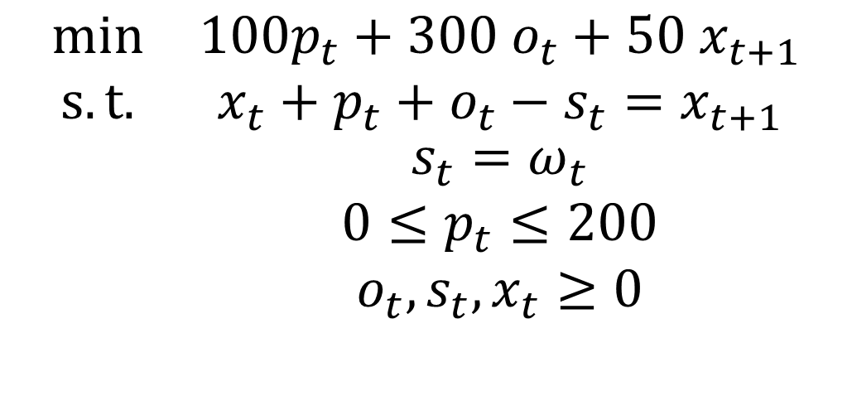
The air-conditioning problem
$$\begin{matrix}min & 100p_{t}+300 o_{t}+50 x_{t+1} \\ s.t. & x_{t}+p_{t}+o_{t}−s_{t}=x_{t+1} \\ & \begin{aligned}s_{t}=ω_{t} \\ 0≤p_{t}≤200 \\ o_{t}, s_{t}, x_{t}≥0\end{aligned}\end{matrix}$$
using JuMP, SDDP, Clp
m = SDDPModel(
stages = 3,
objective_bound = 0.0,
sense = :Min,
solver = ClpSolver()
) do sp, t
@state(sp, xt_1 >= 0, xt == 0)
@variables(sp, begin
0 <= pt <= 200
ot >= 0
st >= 0
end)
@constraint(sp, xt + pt + ot – st == xt_1)
D = [ [100], [100, 300], [100, 300] ]
@rhsnoise(sp, wt=D[t], st == wt)
P = [ [1.0], [0.5, 0.5], [0.5, 0.5] ]
setprobability!(sp, P[t])
@stageobjective(sp, 100 * pt + 300 * ot + 50 * xt_1)
end

Slide 68
The air-conditioning problem
julia> solve(m, max_iterations=10)
--------------------------------------------------------------------------------
SDDP Solver. © Oscar Dowson, 2017.
--------------------------------------------------------------------------------
Solver:
Serial solver
Model:
Stages: 3
States: 1
Subproblems: 3
Value Function: Default
--------------------------------------------------------------------------------
Objective | Cut Passes Simulations Total
Simulation Bound % Gap | # Time # Time Time
--------------------------------------------------------------------------------
70.000K 60.000K | 1 1.0 0 0.0 1.0
62.500K 62.500K | 2 1.0 0 0.0 1.1
55.000K 62.500K | 3 1.0 0 0.0 1.1
55.000K 62.500K | 4 1.0 0 0.0 1.1
60.000K 62.500K | 5 1.0 0 0.0 1.1
95.000K 62.500K | 6 1.0 0 0.0 1.1
40.000K 62.500K | 7 1.0 0 0.0 1.1
60.000K 62.500K | 8 1.0 0 0.0 1.1
40.000K 62.500K | 9 1.0 0 0.0 1.1
95.000K 62.500K | 10 1.0 0 0.0 1.1
--------------------------------------------------------------------------------
Other Statistics:
Iterations: 10
Termination Status: max_iterations
================================================================================

Slide 69
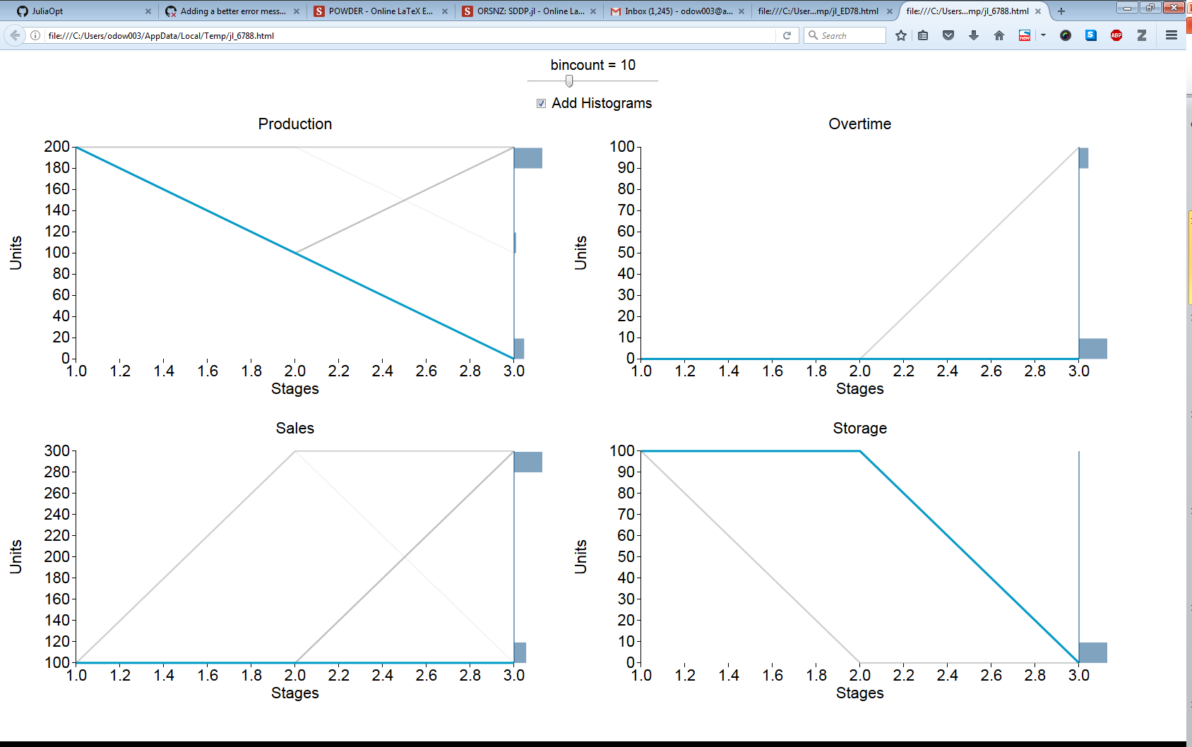

Slide 70
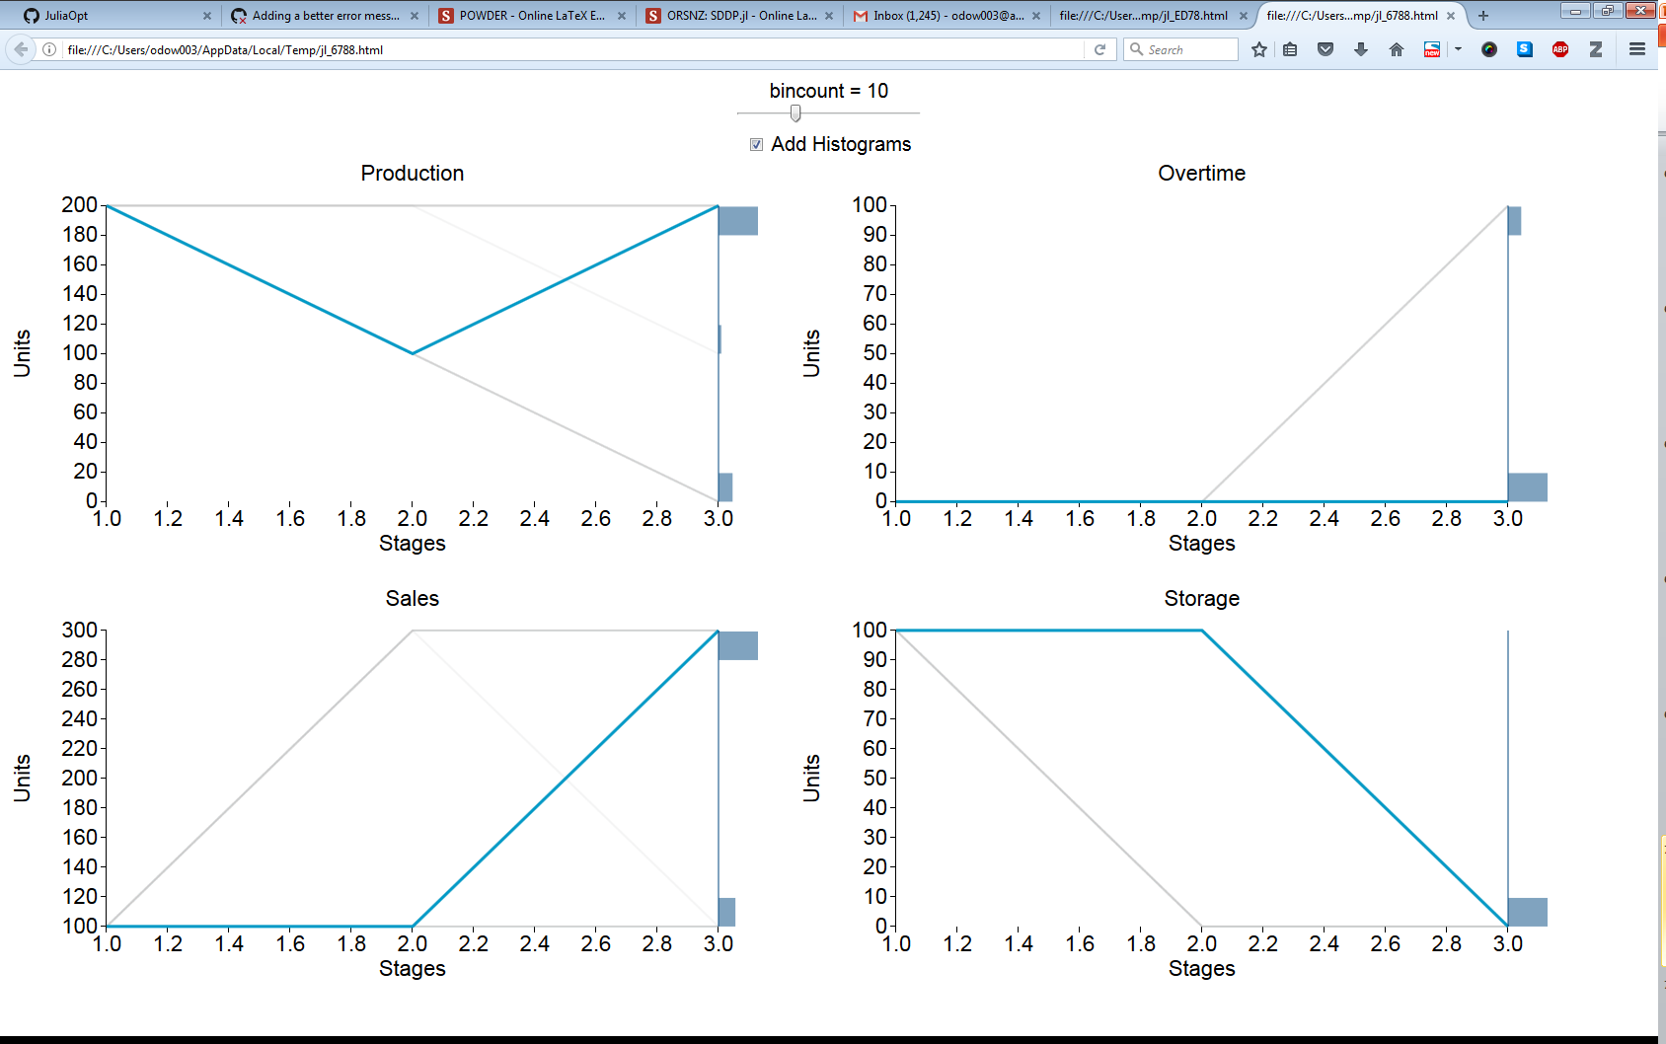

Slide 71
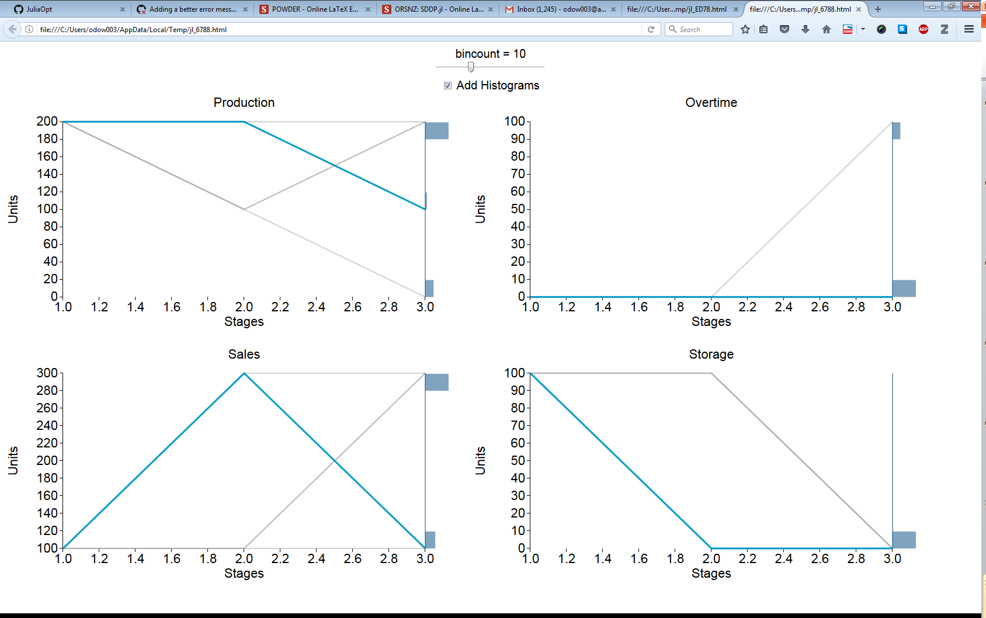

Slide 72
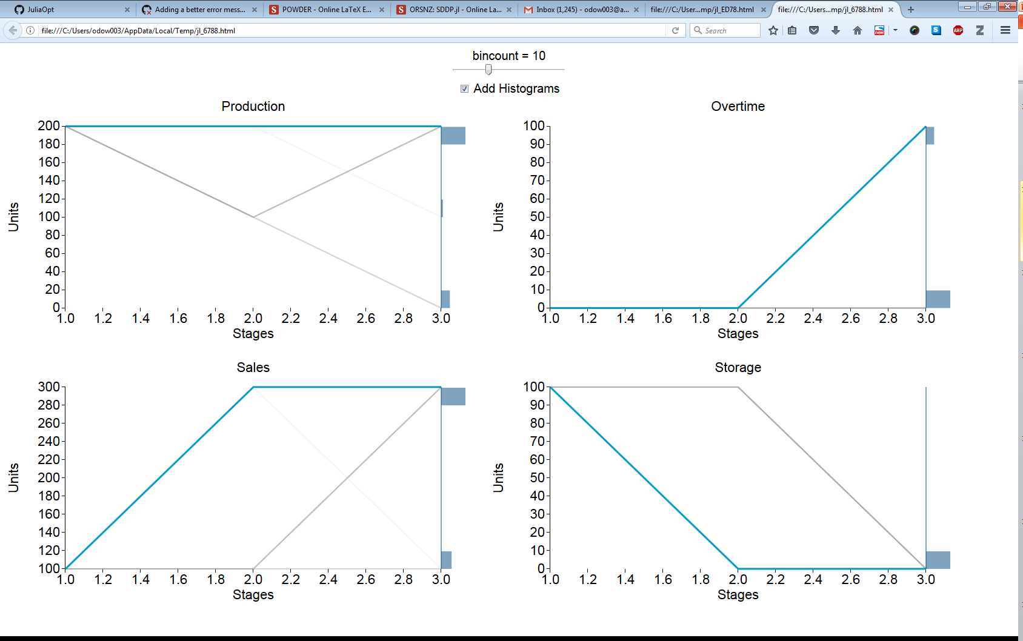

Slide 73
Benchmarking
The NZ Hydro-Thermal Scheduling Problem

Slide 74
Correctness I
 | DOASA | SDDP.jl
2005 | 493,125,281 | 493,125,281
2006 | 423,420,729 | 423,420,729
2007 | 575,859,349 | 575,859,349
2008 | 446,507,222 | 446,507,222
2009 | 340,096,459 | 340,096,459

Slide 75
Correctness II

Slide 76
Performance

Slide 77
Performance
+29%
-16%

